Slide 1
Rock-Type Classification and Prediction In Volve Field
Judah Odiachi

Slide 2
Introduction
Description of the problem
Well Logs data can be used in describing electrofacies. These well logs are used as feed input in determining clusters.
With the availability of actual mineralogy data, in some wells, I attempt to use the well log data for supervised learning.
Actual mineralogy quantification is quite expensive, hence machine learning
With the rock type clusters, saturation and resistivity data can be compared to identify sweet spots in the reservoir
Dataset
Volve field

Slide 3
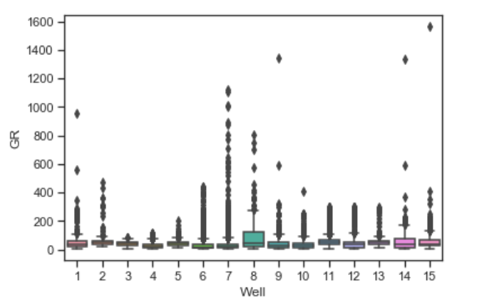
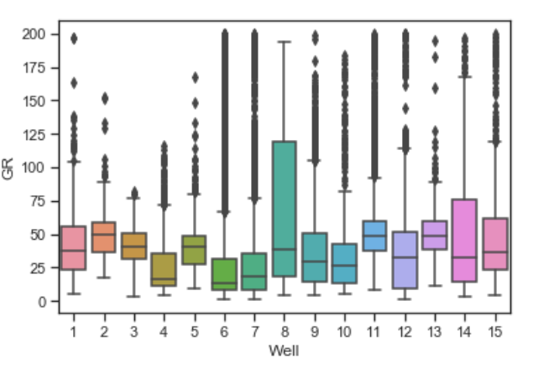
Description of Workflow
Acquire Mineralogy Data & Well Log Data
Mineralogy and Well Log Data should match depth
Perform unsupervised learning on mineralogy data
Mineralogy data: Composition of Quartz, Shale, Carbonates
K-means and Ward Hierarchical Clustering
Perform supervised learning on well log data
Features: Gamma Ray Log, Neutron Porosity Log, Density Log
Labels: Rock Type
Algorithms: K Nearest Neighbors (KNN), Support Vector Machines (SVM), Random Forest (RF)
Cleaned Log Data removing outliers in GR and NPHI log
Add Noise to Dataset and Evaluate impact

Slide 4
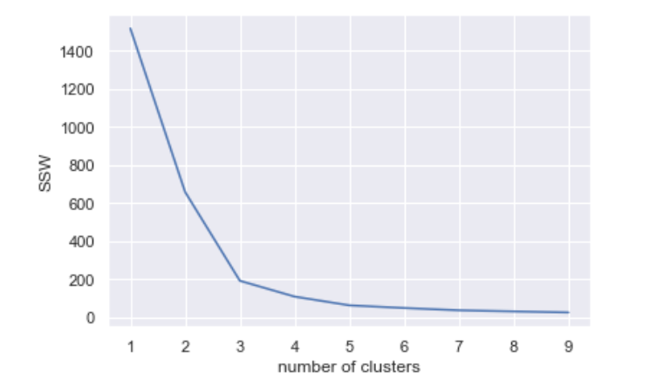
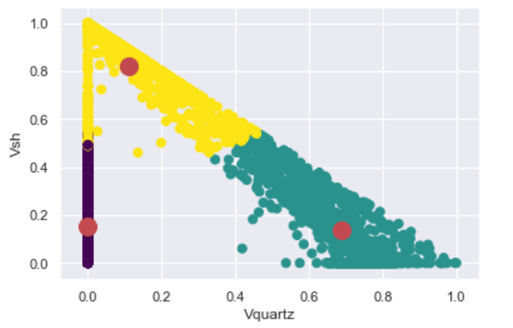
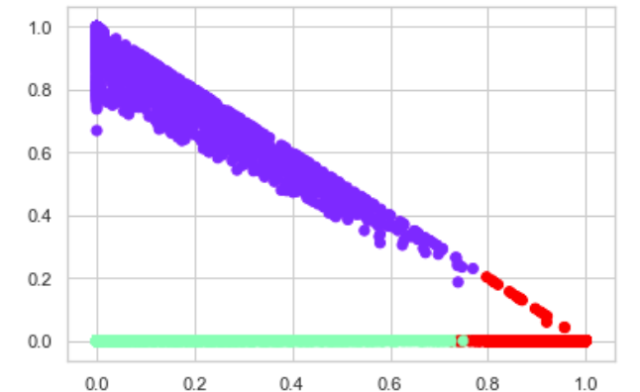
Unsupervised Clustering
K – Means Clustering
Ward Hierachical Clustering

Slide 5
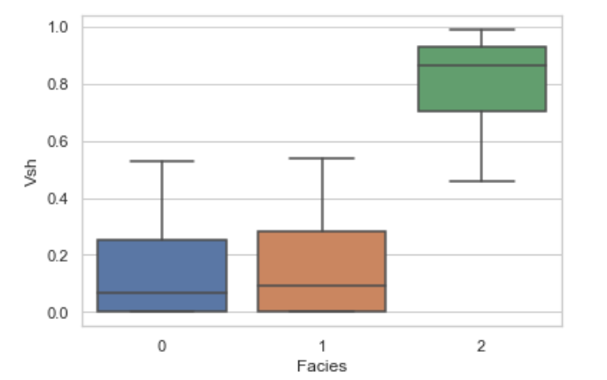
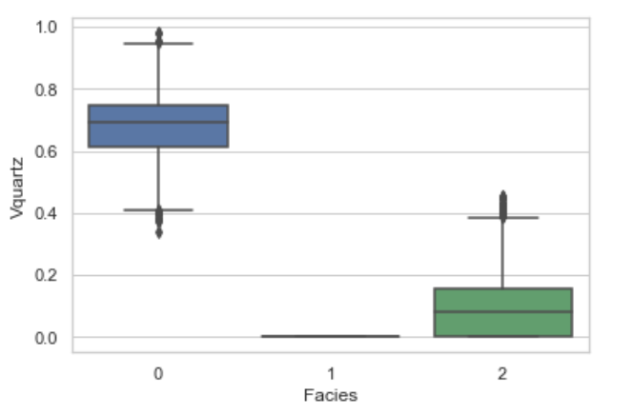
Unsupervised Learning

Slide 6
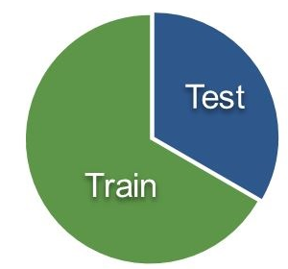
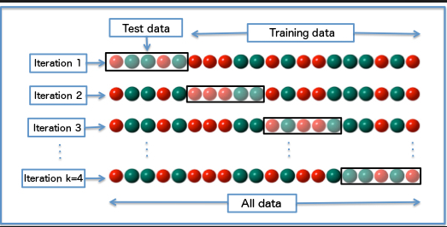
Supervised Learning
Test- Train Split
K-Fold Cross Validation
Wikipedia

Slide 7
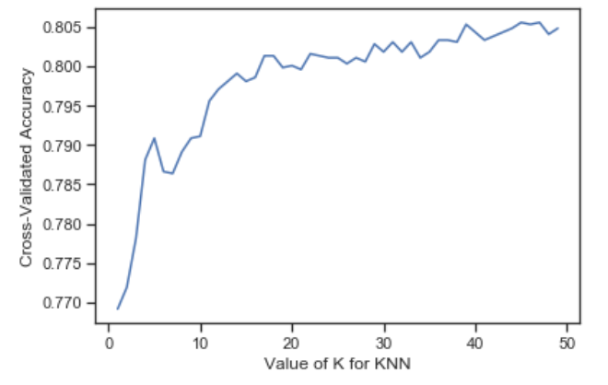
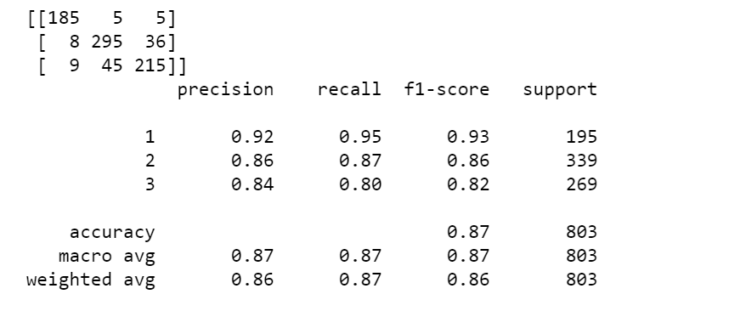
Supervised Learning (KNN)
Confusion Matrix
Classification Report

Slide 8
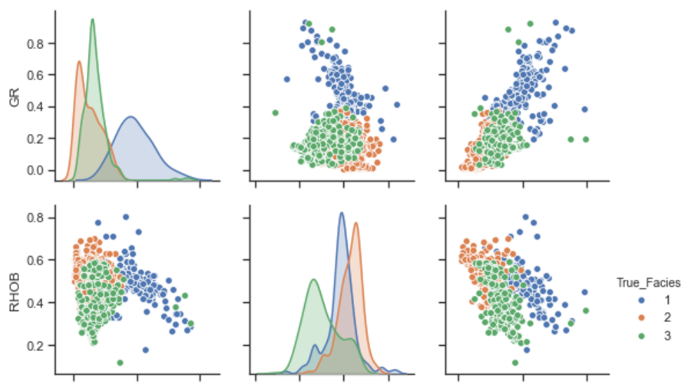
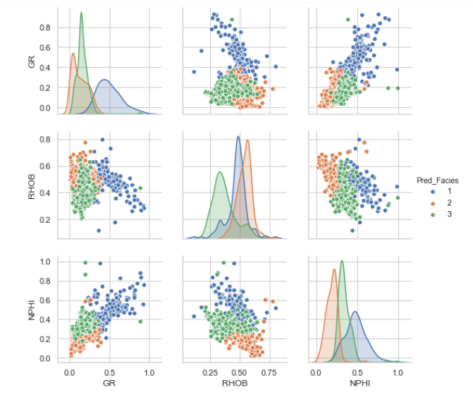
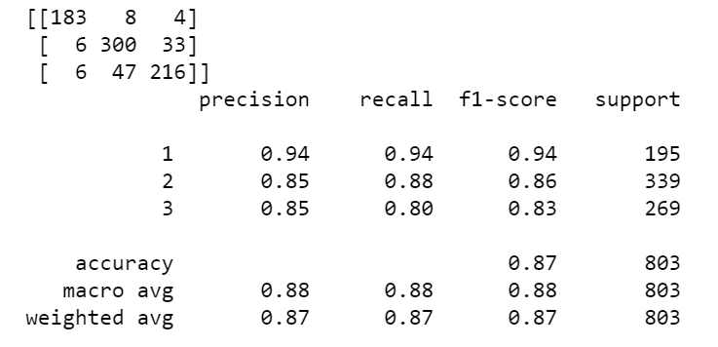
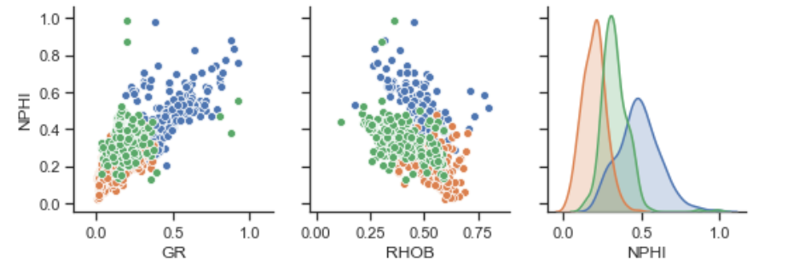
Supervised Learning (SVM)
Confusion Matrix
Classification Report

Slide 9
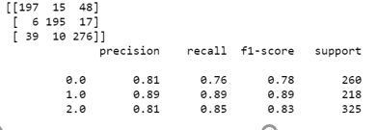
Supervised Learning (SVM)
Classification Report
Confusion Matrix

Slide 10
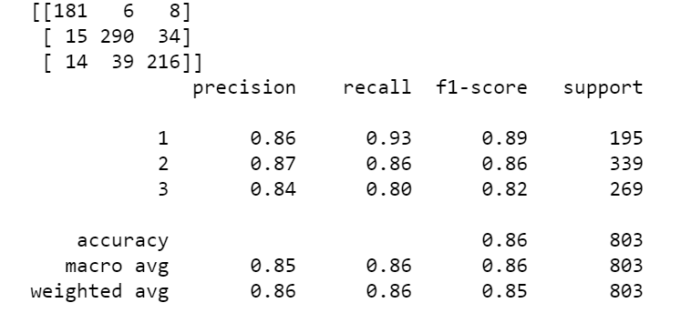
Supervised Learning Random Forest
Confusion Matrix
Classification Report

Slide 11
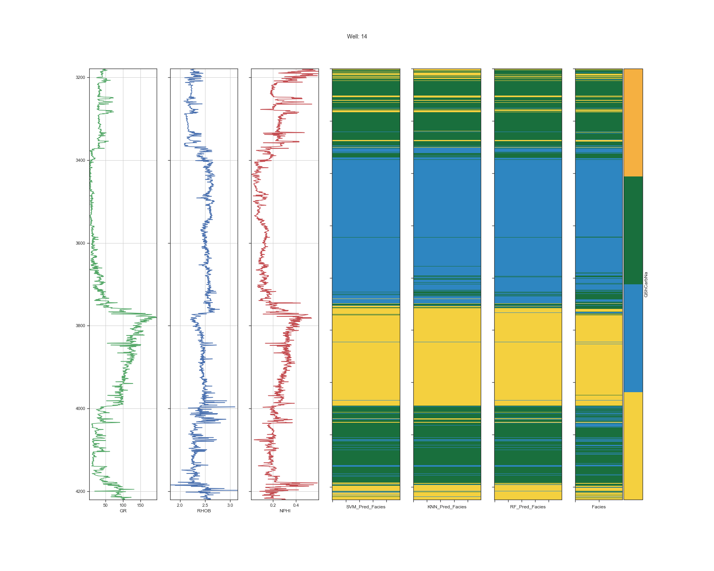
Supervised Learning (Comparison of Prediction Techniques)
Well 14
3200
3400
3600
3800
4000
4200
GR RHOB NPHI SVM KNN RF Facies

Slide 12
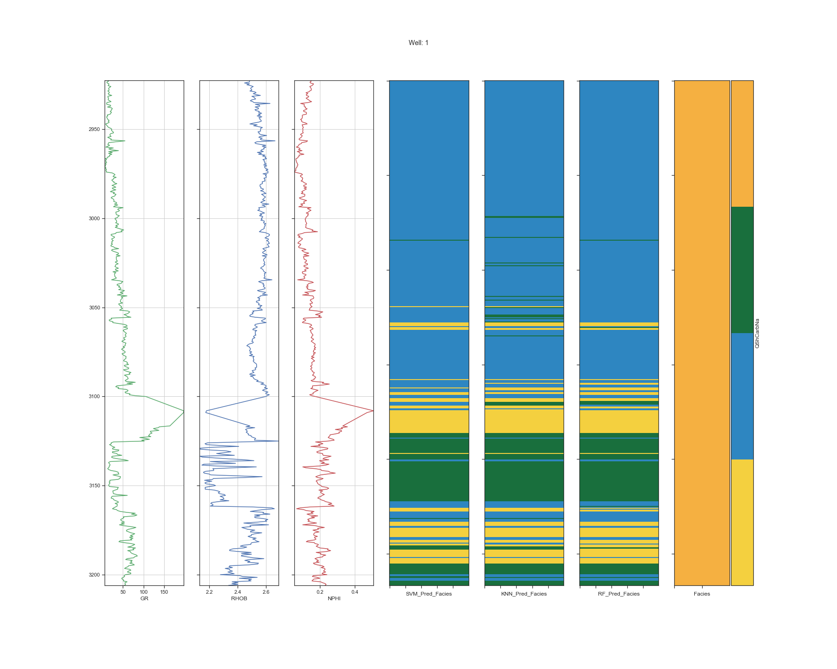
Supervised Learning (Prediction for Well without mineralogy data)
Well 1
2950
3000
3050
3100
3150
3200
GR RHOB NPHI SVM KNN RF Facies

Slide 13
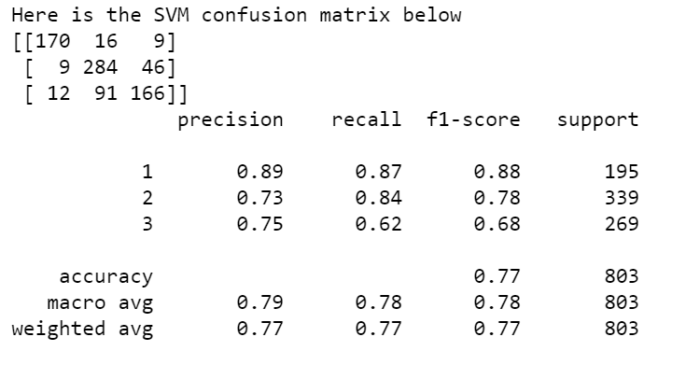
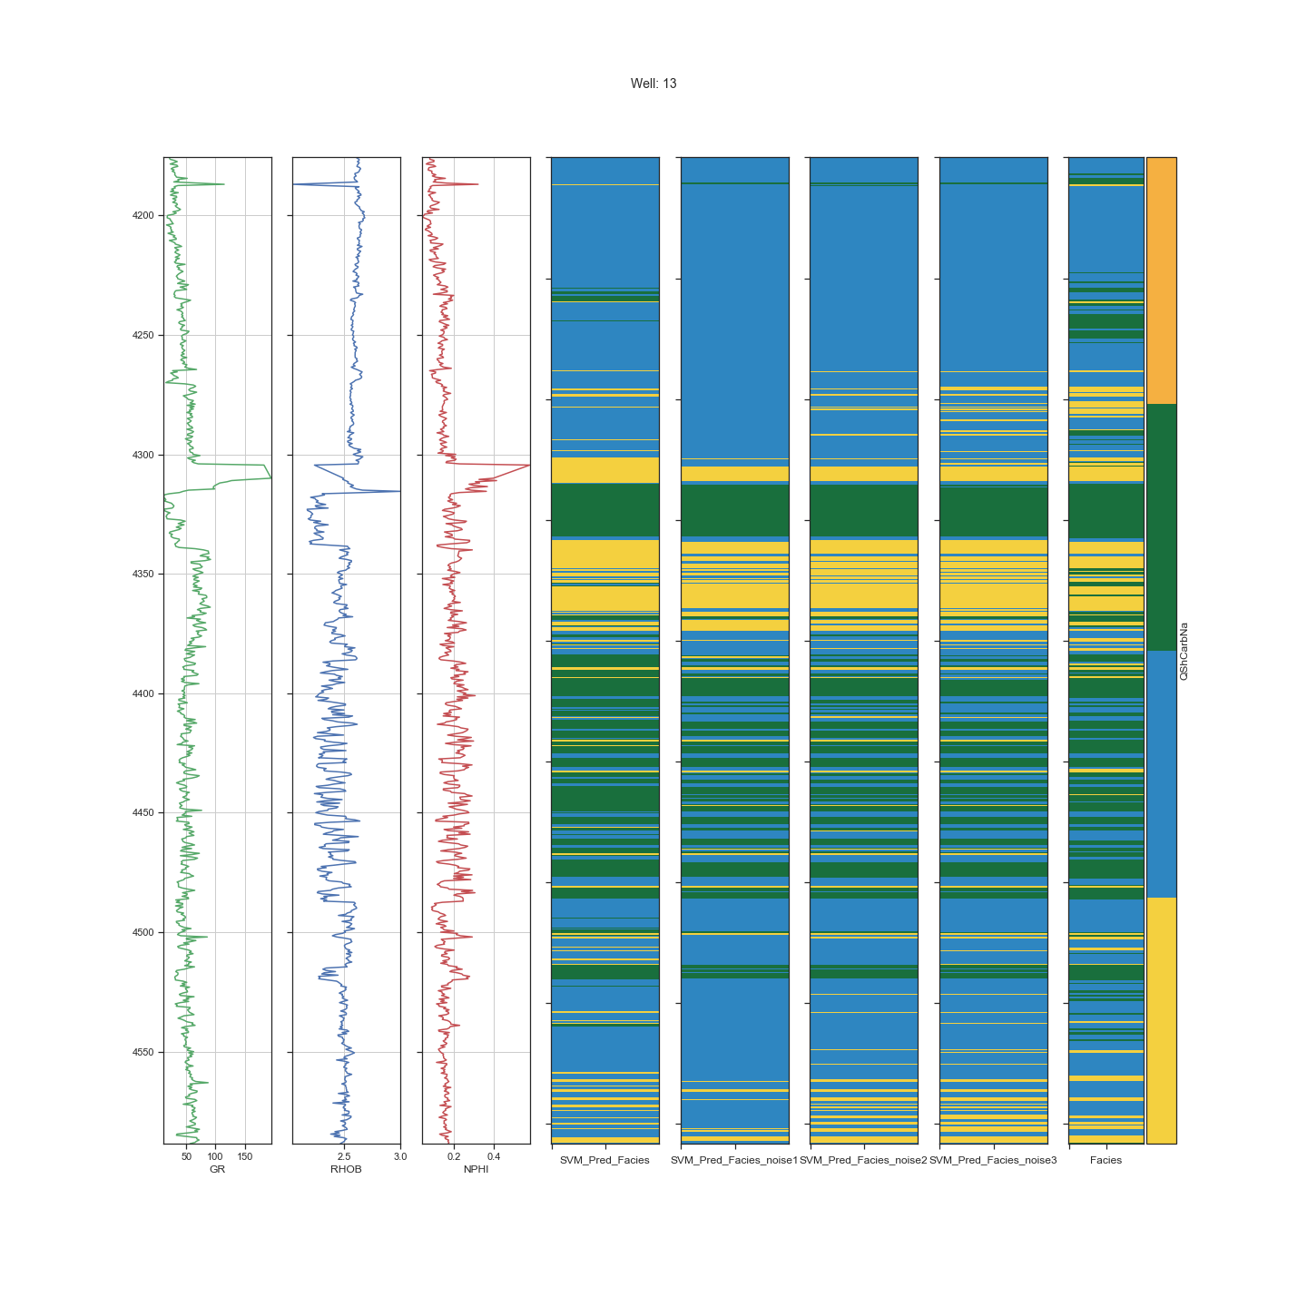
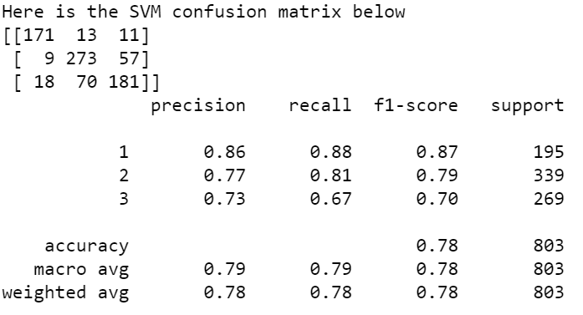
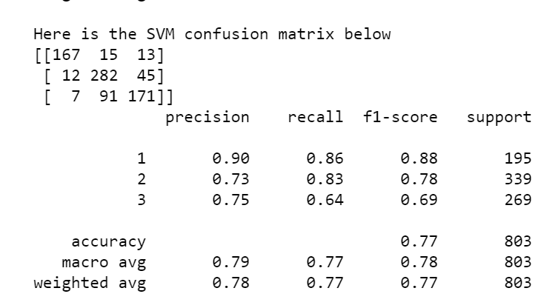
Noise Addition to Evaluate Supervised Learning Techniques
Noise Level 1
Well 13
4200
4250
4300
4350
4400
4450
4500
4550
Noise Level 2
Noise Level 3
GR RHOB NPHI SVM SVM_N1 SVM_N2 SVM_N3 Facies

Slide 14
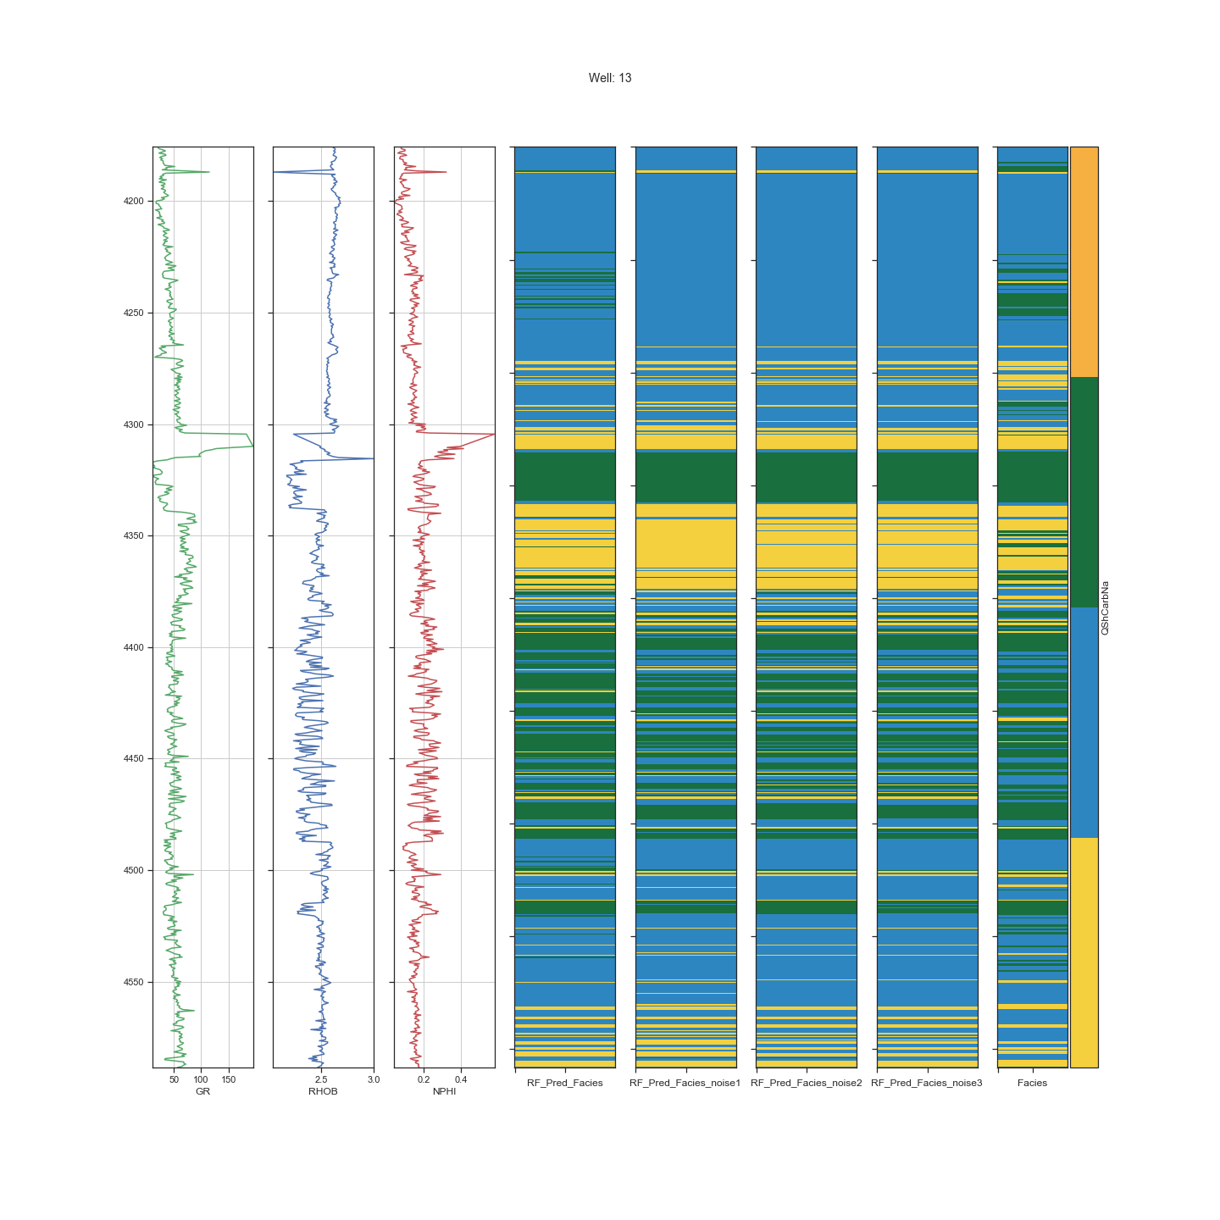
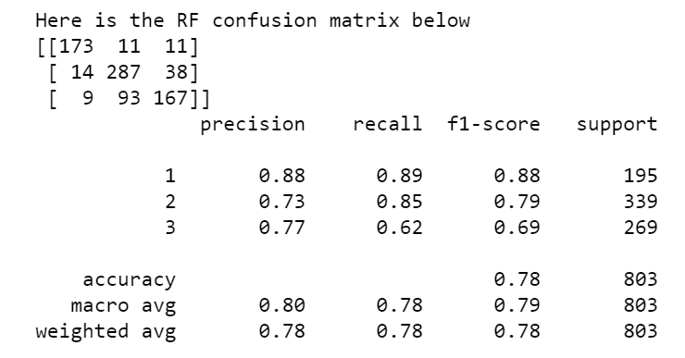
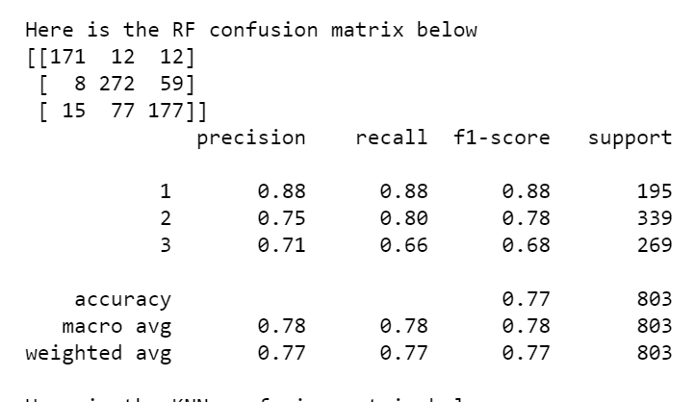
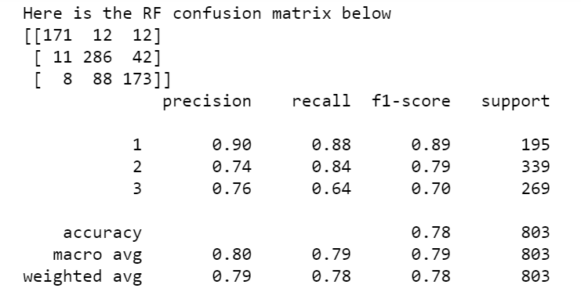
Noise Addition to Evaluate Supervised Learning Techniques
Well 13
Noise Level 1
4200
4250
4300
4350
4400
4450
4500
4550
Noise Level 2
Noise Level 3
GR RHOB NPHI RF RF_N1 RF_N2 RF_N3 Facies

Slide 15
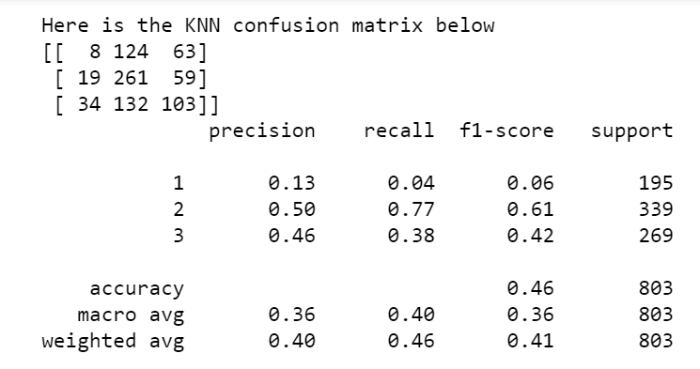
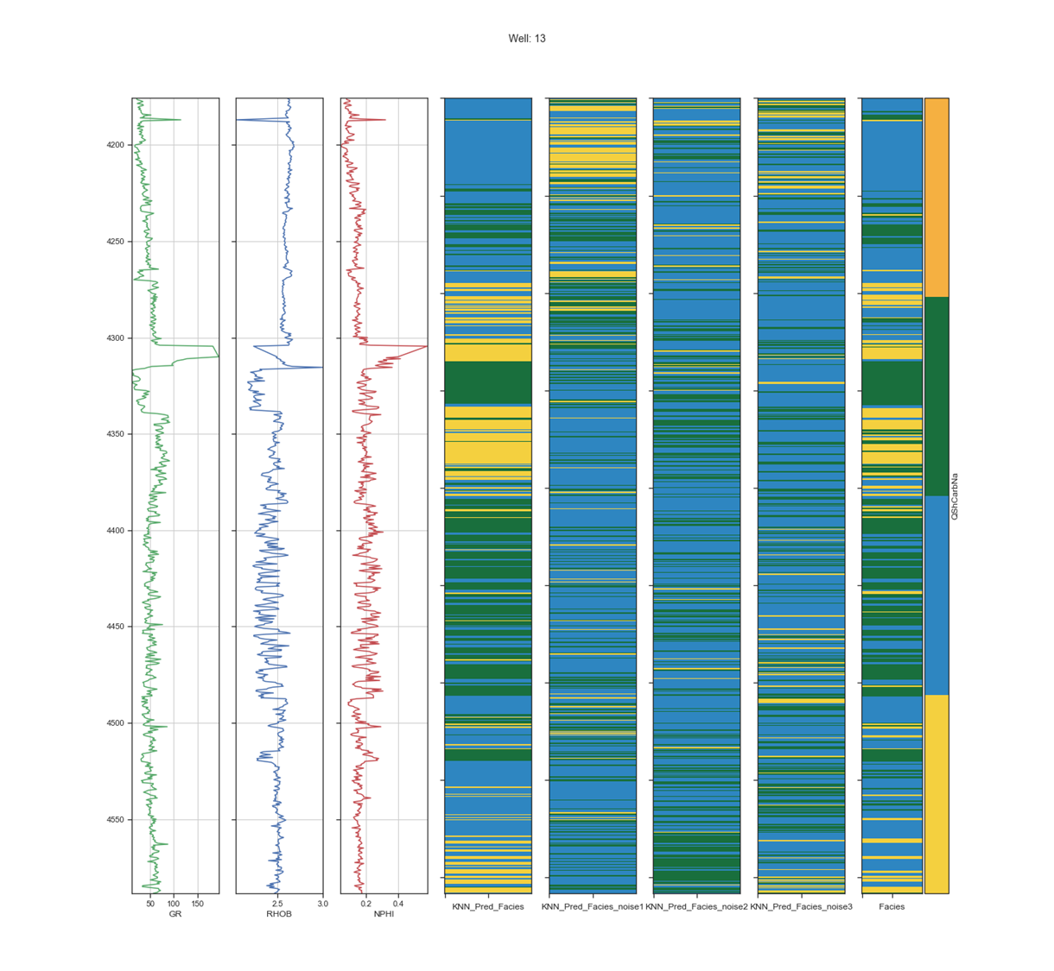
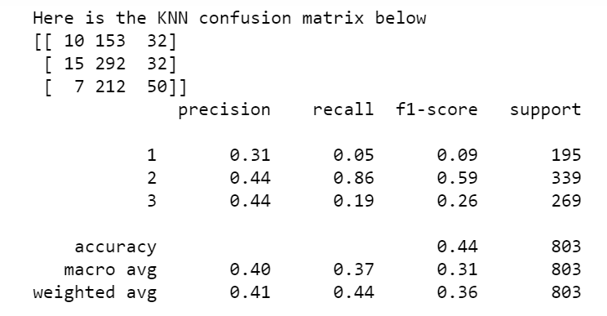
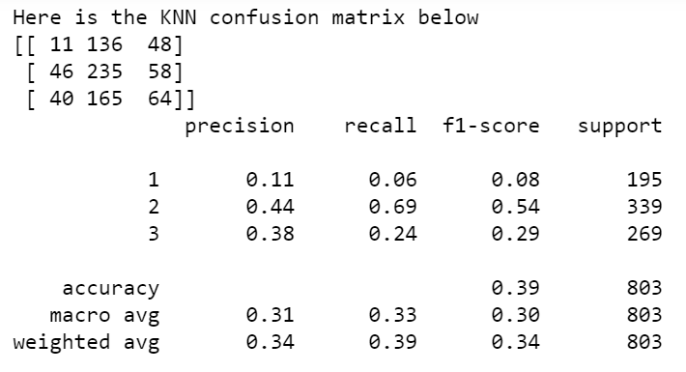
Noise Addition to Evaluate Supervised Learning Techniques
Well 13
Noise Level 1
4200
4250
4300
4350
4400
4450
4500
4550
Noise Level 2
Noise Level 3
GR RHOB NPHI KNN KNN_N1 KNN_N2 KNN_N3 Facies

Slide 16
Conclusions
The two unsupervised learning techniques; K-means and Ward hierarchical clustering performed well in classification of the rock types.
KNN, SVM and Random Forest perform efficiently in predicting the rock types.
KNN performs very poorly in predicting rock types in the presence of noise, while SVM and KNN handle noise effectively.

Slide 17
References
Mukherjee A., Dasgupta T., Sahoo A., Srivastava M., (2017, December 6). Delineating Shale Reservoir through Electrofacies Analysis: A New Approach. AAPG GTW Oil and Gas Resources of India: Exploration and Production Opportunities and Challenges.
Gupta I., Tran N., Devegowda D., Jayaram V., Rai C., Sondergeld C., Karami H. (2020, January 1). Looking Ahead of the Bit Using Surface Drilling and Petrophysical Data: Machine-Learning-Based Real-Time Geosteering in Volve Field. Society of Petroleum Engineers. doi:10.2118/199882-PA

